Slide 1
Transforming and Visualizing Data with pandas
Manipulate Data in DataFrames
Modify Data in DataFrames
Plot DataFrame Data

Slide 2
Manipulate Data in DataFrames
Topic A

Slide 3
The DataFrame.copy() Function
Creates a fully copy of a DataFrame as opposed to a view.
pandas relies on NumPy to decide when a view or copy is returned.
Expect a view when indexing or slicing:
>>> grades_new = grades_num
>>> grades_new.loc['Parker', 'Math'] = numpy.nan
>>> grades_new.loc['Parker', 'Math']
nan
Original DataFrame has been updated:
>>> grades_num.loc['Parker', 'Math']
nan
To prevent this:
>>> grades_new = grades_num.copy()
>>> grades_new.loc['Parker', 'Math'] = numpy.nan
>>> grades_new.loc['Parker', 'Math']
nan
>>> grades_num.loc['Parker', 'Math']
94

Slide 4
The DataFrame.append() Function
Concatenates one DataFrame with another.
Appends by rows.
Example DataFrame of one more student's grades:
grades_rivera = pandas.DataFrame([[74, 79, 89, 91, 83]],
index = ['Rivera'],
columns = ['Math', 'English',
'Science', 'History', 'Business'])
Append to grades_num:
>>> grades_num.append(grades_rivera, sort = False)
Math English Science History Business
Parker 94 83 91 79 NaN
Baldwin 74 65 91 82 NaN
Duncan 96 90 58 89 NaN
Cain 75 74 89 85 NaN
Rivera 74 79 89 91 83.0
Rivera row and Business column are added.
Other students don't have Business values, so they are filled in with NaN.

Slide 5
DataFrame.append() Shortcomings
What if each DataFrame shares some row indices, but different columns?
Example where second DataFrame has more subjects for existing students:
>>> grades_pc_art = pandas.DataFrame([[83],
... [92]],
... index = ['Parker', 'Cain'],
... columns = ['Art'])
>>> grades_pc_art
Art
Parker 83
Cain 92
By using append(), you get duplicate rows at the end for Parker and Cain:
>>> grades_num.append(grades_pc_art, sort = False)
Math English Science History Business Art
Parker 94.0 83.0 91.0 79.0 NaN NaN
Baldwin 74.0 65.0 91.0 82.0 NaN NaN
Duncan 96.0 90.0 58.0 89.0 NaN NaN
Cain 75.0 74.0 89.0 85.0 NaN NaN
Rivera 74.0 79.0 89.0 91.0 83.0 NaN
Parker NaN NaN NaN NaN NaN 83.0
Cain NaN NaN NaN NaN NaN 92.0
Another approach is needed.

Slide 6
The DataFrame.join() Function
Combines data based on row indices.
Example:
>>> grades_num.join(grades_pc_art)
Math English Science History Business Art
Parker 94 83 91 79 NaN 83.0
Baldwin 74 65 91 82 NaN NaN
Duncan 96 90 58 89 NaN NaN
Cain 75 74 89 85 NaN 92.0
Rivera 74 79 89 91 83.0 NaN
Rows no longer duplicated; scores for Art class combined with Parker and Cain rows.
Arguments for configuring join():
on —Specify column or row index name(s) to perform join on.
how —Specify how the join is performed ('left', 'right', 'outer', 'inner').
lsuffix and rsuffix —Specify suffix for name of any overlapping columns.

Slide 7
The DataFrame.pivot() Function
Reshapes a DataFrame based on column values.
Similar to pivoting in Microsoft Excel.
Three arguments:
index —Unique values of provided column will be transformed into rows indices.
columns —Unique values of provided column will be transformed into columns.
values —Values of column(s) provided will populate cells.
sales_df:
Name Product Units Sales
0 Jones Prod1 150 9804.45
1 Jones Prod2 46 5425.32
2 Jones Prod3 176 7834.89
3 Perez Prod1 112 7320.66
4 Perez Prod2 57 6722.58
5 Perez Prod3 143 6365.85
Pivot to show how many units each sales rep sold for each product:
>>> sales_df.pivot(index = 'Name', columns = 'Product', values = 'Units')
Product Prod1 Prod2 Prod3
Name
Jones 150 46 176
Perez 112 57 143

Slide 8
The DataFrame.transpose() Function
Permutes data by flipping rows and columns.
Manipulate orientation of DataFrame without fully pivoting.
Make each subject a row, and each student a column:
>>> grades_num.transpose()
Parker Baldwin Duncan Cain Rivera
Math 94.0 74.0 96.0 75.0 74.0
English 83.0 65.0 90.0 74.0 79.0
Science 91.0 91.0 58.0 89.0 89.0
History 79.0 82.0 89.0 85.0 91.0
Business NaN NaN NaN NaN 83.0
Art 83.0 NaN NaN 92.0 NaN

Slide 9
The DataFrame.sort_values() Function
Sorts values along a specified axis.
Example of sorting Math column by its values:
grades_num.sort_values(by = ['Math'])
Result:
Math English Science History Business Art
Baldwin 74 65 91 82 NaN NaN
Rivera 74 79 89 91 83.0 NaN
Cain 75 74 89 85 NaN 92.0
Parker 94 83 91 79 NaN 83.0
Duncan 96 90 58 89 NaN NaN
Sort on multiple columns by supplying a list:
>>> grades_num.sort_values(by = ['Math', 'Science'])
Math English Science History Business Art
Rivera 74 79 89 91 83.0 NaN
Baldwin 74 65 91 82 NaN NaN
Cain 75 74 89 85 NaN 92.0
Parker 94 83 91 79 NaN 83.0
Duncan 96 90 58 89 NaN NaN
Set axis = 1 to sort on row values.

Slide 10
The DataFrame.sort_index() Function
Sorts DataFrame by index labels (row or column).
Sort by row labels:
>>> grades_num.sort_index(axis = 0)
Math English Science History Business Art
Baldwin 74 65 91 82 NaN NaN
Cain 75 74 89 85 NaN 92.0
Duncan 96 90 58 89 NaN NaN
Parker 94 83 91 79 NaN 83.0
Rivera 74 79 89 91 83.0 NaN
Sort by column labels in descending order:
>>> grades_num.sort_index(axis = 1, ascending = False)
Science Math History English Business Art
Parker 91 94 79 83 NaN 83.0
Baldwin 91 74 82 65 NaN NaN
Duncan 58 96 89 90 NaN NaN
Cain 89 75 85 74 NaN 92.0
Rivera 89 74 91 79 83.0 NaN

Slide 11
Grouping
Name | Units | Sales
Jones | 150 | 9804.45
Jones | 46 | 5425.32
Jones | 176 | 7834.89
Name | Units | Sales
Perez | 112 | 7320.66
Perez | 57 | 6722.58
Perez | 143 | 6365.85
Split
Apply
Name | Units | Sales
Jones | 372 | 23064.66
Name | Units | Sales
Perez | 312 | 20409.09
Name | Units | Sales
Jones | 372 | 23064.66
Perez | 312 | 20409.09
Combine

Slide 12
The DataFrame.groupby() Function
Performs the three-step grouping process.
Takes a key or group of keys it will use to determine split.
Usually a column of repeated values relating to a group.
Example: Name is a good key for sales_df.
Group by sales rep:
sales_df.groupby('Name')
Returns GroupBy object that performs split.
Call function you want to apply to group:
>>> sales_df.groupby('Name').sum()
Units Sales
Name
Jones 372 23064.66
Perez 312 20409.09
Use indexing and slicing to get only relevant columns:
>>> sales_df.groupby('Name')['Units'].sum()
Name
Jones 372
Perez 312

Slide 13
Multi-Indexing (Slide 1 of 2)
Some datasets have a hierarchy of indices.
Example where grades_num also includes students' grades per year:
Math English ...
Parker 2019 94 83
Parker 2020 92 87
Baldwin 2019 74 65
Baldwin 2020 81 66
...
Not easy to extract all grades from 2019.
Multi-indexing includes multiple row indices at different levels.
Easier to manipulate and modify hierarchical datasets.
Creates MultiIndex object.

Slide 14
Multi-Indexing (Slide 2 of 2)
Supply a list of lists to index argument for multiple indices.
First list is first row index, second list is second row index, etc.
Example:
>>> data = numpy.array([[94, 83],
... [92, 87],
... [74, 65],
... [81, 66]])
>>> mult_ind = [['Parker', 'Parker', 'Baldwin', 'Baldwin'],
... [2019, 2020, 2019, 2020]]
>>> grades_num_yr = pandas.DataFrame(data, index = mult_ind,
... columns = ['Math', 'English'])
>>> grades_num_yr
Math English
Parker 2019 94 83
2020 92 87
Baldwin 2019 74 65
2020 81 66

Slide 15
Indexing and Slicing MultiIndex Objects
You can use indexing operator like normal for columns:
>>> grades_num_yr['English']
Parker 2019 83
2020 87
Baldwin 2019 65
2020 66
When using loc(), supply a tuple of each row index:
>>> grades_num_yr.loc[('Parker', 2020), :]
Math 92
English 87
Use pandas.IndexSlice to slice a multi-index level:
>>> grades_num_yr.loc[pandas.IndexSlice[:, 2020], :]
Math English
Name Year
Parker 2020 92 87
Baldwin 2020 81 66
Retrieves all students' grades for just 2020.

Slide 16
The DataFrame.stack() and DataFrame.unstack() Functions
Transform DataFrame from single-indexed to multi-indexed and vice versa.
grades_num_yr:
Math English
2019 2020 2019 2020
Parker 94 92 83 87
Baldwin 74 81 65 66
Use stack() to multi-index rows instead of columns.
Math English
Baldwin 2019 74 65
2020 81 66
Parker 2019 94 83
2020 92 87
Use unstack() to pivot back to column multi-index:
English Math
2019 2020 2019 2020
Baldwin 65 66 74 81
Parker 83 87 94 92
Both functions sort index labels.

Slide 17
Guidelines for Manipulating Data in DataFrames
Remember that pandas relies on NumPy to decide whether a view or a copy is returned.
Use copy() to return a copy.
Use append() to concatenate DataFrames.
Adds new rows by default.
Use join() to merge rows with similar values.
Specify join approach using how argument.
Use pivot() to reshape and summarize data.
Use pivot_table() if there are duplicate values.
Use transpose() to permute data.
Use sort_values() to sort values.
Use sort_index() to sort row and/or column indices.
Use grouping to summarize related portions of dataset.
Use groupby() with label whose unique values you want to group.
Call the desired summary function on grouping.
Consider multi-indexing a hierarchical dataset.
Supply a tuple of levels when indexing/slicing a multi-indexed DataFrame.
Use IndexSlice to slice on levels themselves.
Use stack() and unstack() to go from single-indexed to multi-indexed and vice versa.

Slide 18
Activity: Manipulating Data in DataFrames
You need to incorporate invoice data you worked on earlier into the DataFrame.
You need to add customer ratings for each transaction as well.
Once the dataset is filled out, you can rearrange it:
Sort the data by invoice IDs.
Pivot and group data to see store performance, product line sales, and male vs. female ratings.

Slide 19
Modify Data in DataFrames
Topic B

Slide 20
The DataFrame.rename() Function
Renames row or column labels.
Supply a dictionary where each key is the current label, each value is the new label.
Example:
new_names = {'Math': 'Calculus', 'Science': 'Physics'}
grades_num.rename(mapper = new_names, axis = 1)
Result:
Calculus English Physics History Business Art
Parker 94 83 91.0 79 NaN 83.0
Baldwin 74 65 91.0 82 NaN NaN
Duncan 96 90 NaN 89 NaN NaN
Cain 75 74 89.0 85 NaN 92.0
Rivera 74 79 89.0 91 83.0 NaN
You can also feed a dictionary to either the index (rows) or columns arguments.

Slide 21
The DataFrame.fillna() Function
Replaces all NaN values with value you specify (or a dictionary of values).
You can specify axis on which to fill missing values.
Example replaces all NaN with group grades for each subject:
grades_num.fillna({'Business': 84, 'Art': 91}).astype('int64')
Key is column, value is what NaN will be replaced with.
Result:
Calculus English Physics History Business Art
Parker 94 83 91 79 84 83
Baldwin 74 65 91 82 84 91
Duncan 96 90 58 89 84 91
Cain 75 74 89 85 84 92
Rivera 74 79 89 91 83 91

Slide 22
The DataFrame.where() Function
Replaces values when a given condition is false.
cond argument is condition, other is the value to change to.
Example changes failing grades to 60:
grades_num.where(grades_num > 59, 60)
Grades not above 59 will be changed to 60.
Result:
Calculus English Physics History Business Art
Parker 94 83 91 79 84 83
Baldwin 74 65 91 82 84 91
Duncan 96 90 60 89 84 91
Cain 75 74 89 85 84 92
Rivera 74 79 89 91 83 91
You can accomplish same thing with a mask:
grades_num[grades_num < 60] = 60
Mask changes data in place, where() does not.

Slide 23
DataFrame Arithmetic Functions and Operators (Slide 1 of 2)
sliced = grades_num.loc['Baldwin':'Duncan', 'Calculus':'English']
Function | Wrapper Operator | Example
DataFrame.add() | + | >>> sliced + 3 Calculus English Baldwin 77 68 Duncan 99 93
DataFrame.sub() | - | >>> sliced – 3 Calculus English Baldwin 71 62 Duncan 93 87
DataFrame.mul() | * | >>> sliced * 2 Calculus English Baldwin 148 130 Duncan 192 180
DataFrame.div() | / | >>> sliced / 3 Calculus English Baldwin 24.666667 21.666667 Duncan 32.000000 30.000000

Slide 24
DataFrame Arithmetic Functions and Operators (Slide 2 of 2)
sliced = grades_num.loc['Baldwin':'Duncan', 'Calculus':'English']
Function | Wrapper Operator | Example
DataFrame.floordiv() | // | >>> sliced // 3 Calculus English Baldwin 24 21 Duncan 32 30
DataFrame.mod() | % | >>> sliced % 3 Calculus English Baldwin 2 2 Duncan 0 0
DataFrame.power() | ** | >>> sliced ** 2 Calculus English Baldwin 5476 4225 Duncan 9216 8100

Slide 25
Operating on Mixed Data Types
N/A means student hasn't taken course, P means score is pending:
Calculus English Physics History Business Art
Parker 94 83 N/A 79 84 83
Baldwin 74 65 91 82 84 91
Duncan 96 90 60 89 P 91
Cain 75 N/A 89 85 84 92
Rivera 74 79 89 91 83 91
Grading History class on a curve is easy:
>>> grades_num['History'] = (10 * grades_num['History'] ** .5).astype('int64')
>>> grades_num
Calculus English Physics History Business Art
Parker 94 83 N/A 88 84 83
Baldwin 74 65 91 90 84 91
Duncan 96 90 60 94 P 91
Cain 75 N/A 89 92 84 92
Rivera 74 79 89 95 83 91
What about columns that aren't numeric?
Curve calculation won't work on Physics, for example.
You need to convert the data to a numeric format first.

Slide 26
The pandas.to_numeric() Function
Converts data to numeric type.
Some conversions happen directly, like 8 (string) to 8 (integer).
Some need to be handled in one of three ways (errors argument):
'raise' —Python throws an exception; conversion fails.
'coerce' —Values will be converted to NaN.
'ignore' —Values will remain as they are.
Must use apply() with to_numeric() when working with a DataFrame:
>>> grades_num = grades_num.apply(pandas.to_numeric, errors = 'coerce')
>>> grades_num ** .5 * 10
Calculus English Physics History Business Art
Parker 96.953597 91.104336 NaN 93.808315 91.651514 91.104336
Baldwin 86.023253 80.622577 95.393920 94.868330 91.651514 95.393920
Duncan 97.979590 94.868330 77.459667 96.953597 NaN 95.393920
Cain 86.602540 NaN 94.339811 95.916630 91.651514 95.916630
Rivera 86.023253 88.881944 94.339811 97.467943 91.104336 95.393920
To convert to integers, you would need to handle NaN values.

Slide 27
The pandas.to_datetime() Function
Date and/or time data might be loaded as a string object.
Convert to datetime format to make it easier to operate on.
pandas.to_datetime() can directly convert many formats:
>>> dates = pandas.Series(['1/30/2020', '2020/1/30',
'1-30-2020', 'January 30, 2020'])
>>> pandas.to_datetime(dates)
0 2020-01-30
1 2020-01-30
2 2020-01-30
3 2020-01-30
dtype: datetime64[ns]

Slide 28
Arithmetic on Multiple DataFrames (Slide 1 of 2)
Summarized version of sales_df:
Units Sales
Jones 372 23064.66
Perez 312 20409.09
new_sales_df has more figures:
Units Sales
Jones 76 4712.23
Perez 98 6419.01
Adding both together:
>>> sales_df + new_sales_df
Units Sales
Jones 448 27776.89
Perez 410 26828.10

Slide 29
Arithmetic on Multiple DataFrames (Slide 2 of 2)
What about when each DataFrame has a different shape?
new_sales_df with an extra row and column:
Units Sales Clients
Jones 76 4712.23 65
Perez 98 6419.01 41
Stevens 43 2537.64 12
Data not in all objects will not be operated on:
>>> sales_df + new_sales_df
Clients Sales Units
Jones NaN 27776.89 448.0
Perez NaN 26828.10 410.0
Stevens NaN NaN NaN
Takes on shape of larger object.
Sorts columns alphabetically.
Marks missing values as NaN.

Slide 30
The DataFrame.drop() Function
Removes entire rows or columns.
Example:
>>> grades_num.drop(labels = ['Business', 'Art'], axis = 1)
Calculus English Physics History
Parker 96 91.0 NaN 93
Baldwin 86 80.0 95.0 94
Duncan 97 94.0 77.0 96
Cain 86 NaN 94.0 95
Rivera 86 88.0 94.0 97
Or, supply labels via index (rows) or columns arguments:
grades_num.drop(columns = ['Business', 'Art'])

Slide 31
Guidelines for Modifying Data in DataFrames
Use rename() to change row and/or column labels.
Use fillna() to fill all missing values.
Use where() to replace values when a condition is false.
Use arithmetic operators to perform calculations on DataFrame data.
Be aware that you can't perform math operations on a non-numeric column.
Use to_numeric() to convert column first.
Use to_datetime() to make date and time values easier to work with.
Use drop() to remove unwanted rows and/or columns.

Slide 32
Activity: Modifying Data in DataFrames
Some cleanup tasks remain:
Rename some of the column labels.
Format Date column as datetime.
Fill in missing values that you have the data for.
Calculate missing revenue values, impute missing COGS values.
Drop rows with erroneous quantities.
You'll also add a column for gross income.

Slide 33
Plot DataFrame Data
Topic C

Slide 34
The DataFrame.plot() Function
Plots DataFrame data in multiple ways.
An interface to a backend plotting library, usually Matplotlib.
Important arguments:
x —Specify data to plot along x-axis.
y —Specify data to plot along y-axis.
kind —Specify type of plot.
Not all plots have x- and y-axis, so you may just need to supply one slice of data.
Function also has many arguments for customizing plots.
For now, you'll become familiar with different plot types.

Slide 35
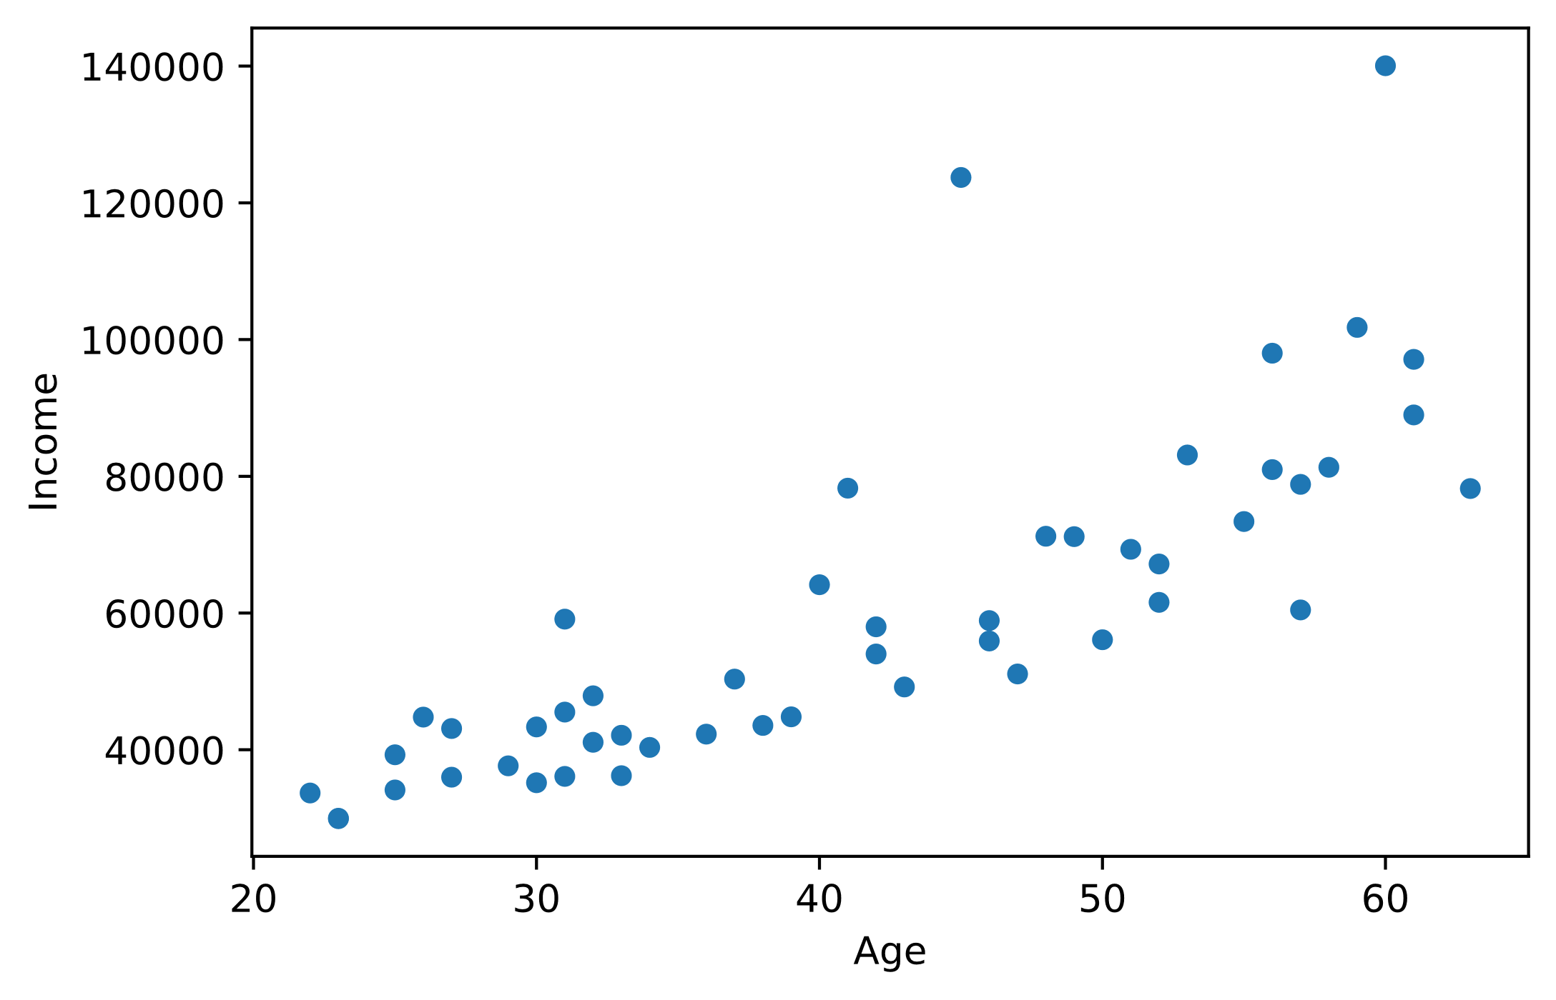
Scatter Plots
census_df.plot(x = 'Age', y = 'Income', kind = 'scatter')
y-axis
Data point
x-axis

Slide 36
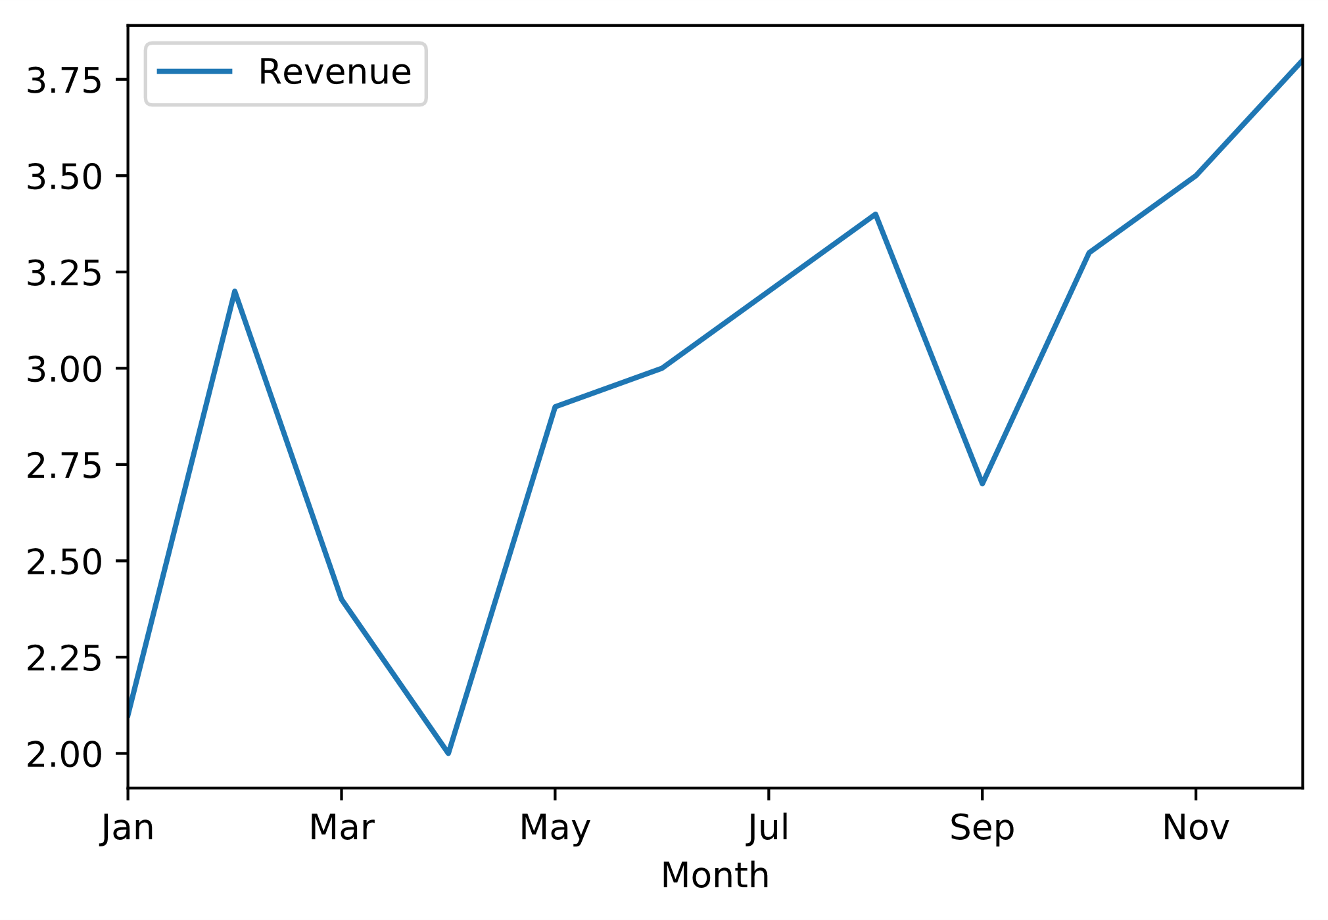
Line Plots
revenue_df.plot(x = 'Month', y = 'Revenue', kind = 'line')
y-axis
Trend line
Data point
x-axis

Slide 37
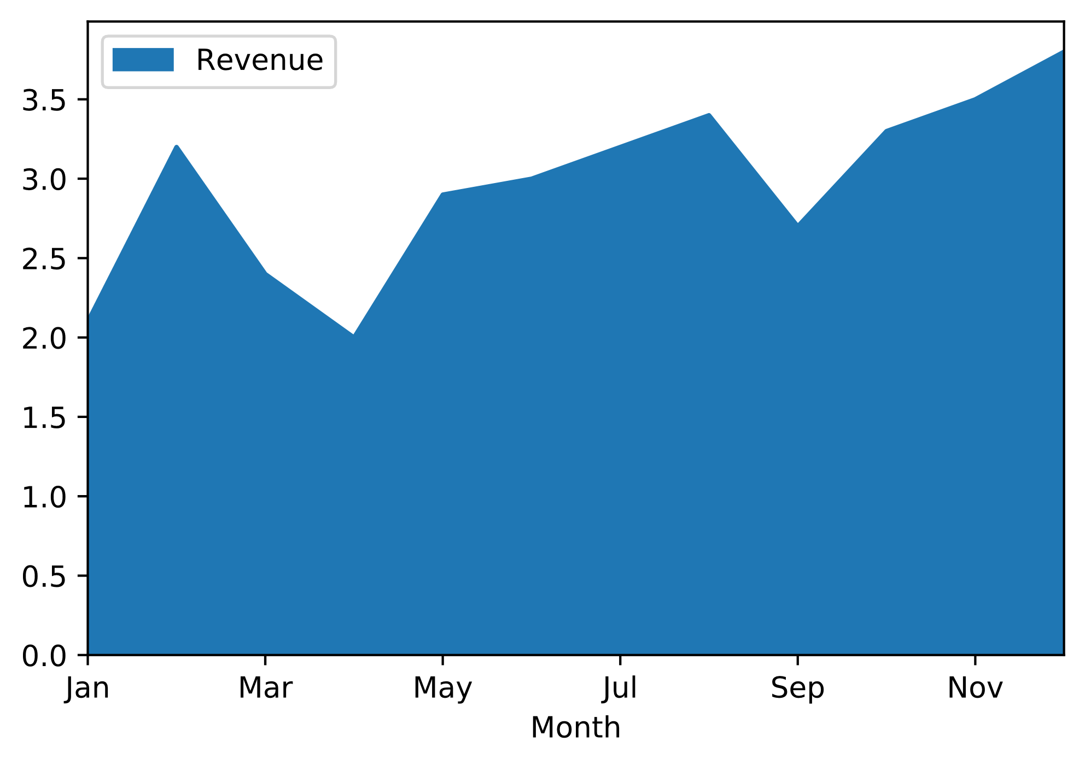
Area Plots
revenue_df.plot(x = 'Month', y = 'Revenue', kind = 'area')
y-axis
Trend area
x-axis

Slide 38
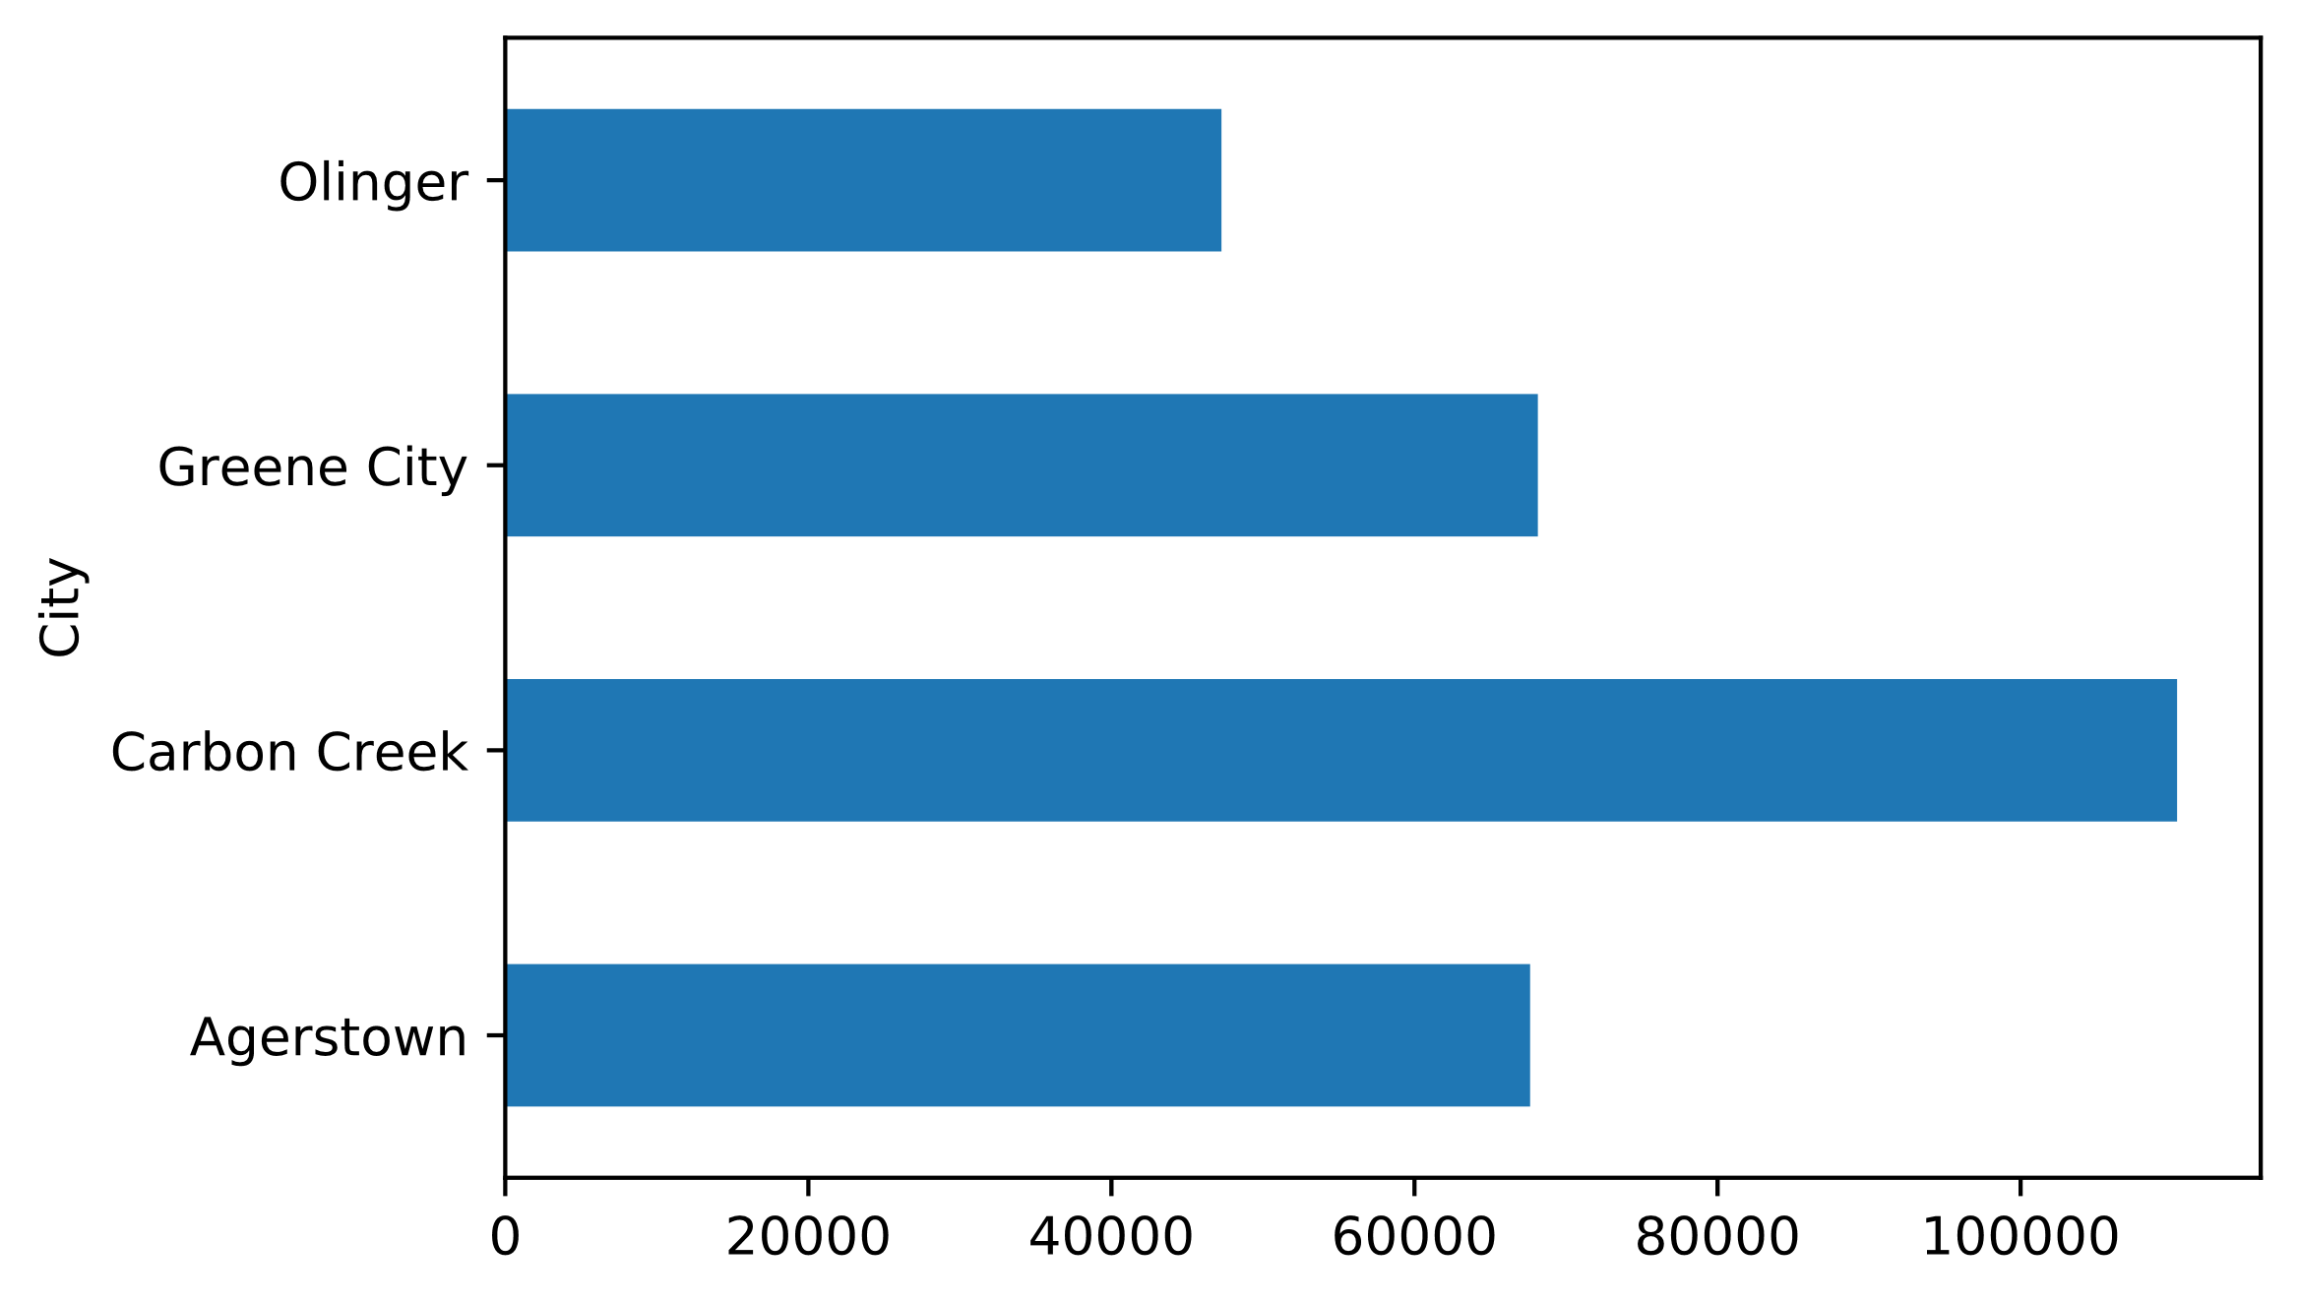
Bar Charts
census_df.groupby('City')['Income'].mean().plot(kind = ‘barh')
City with largest mean income

Slide 39
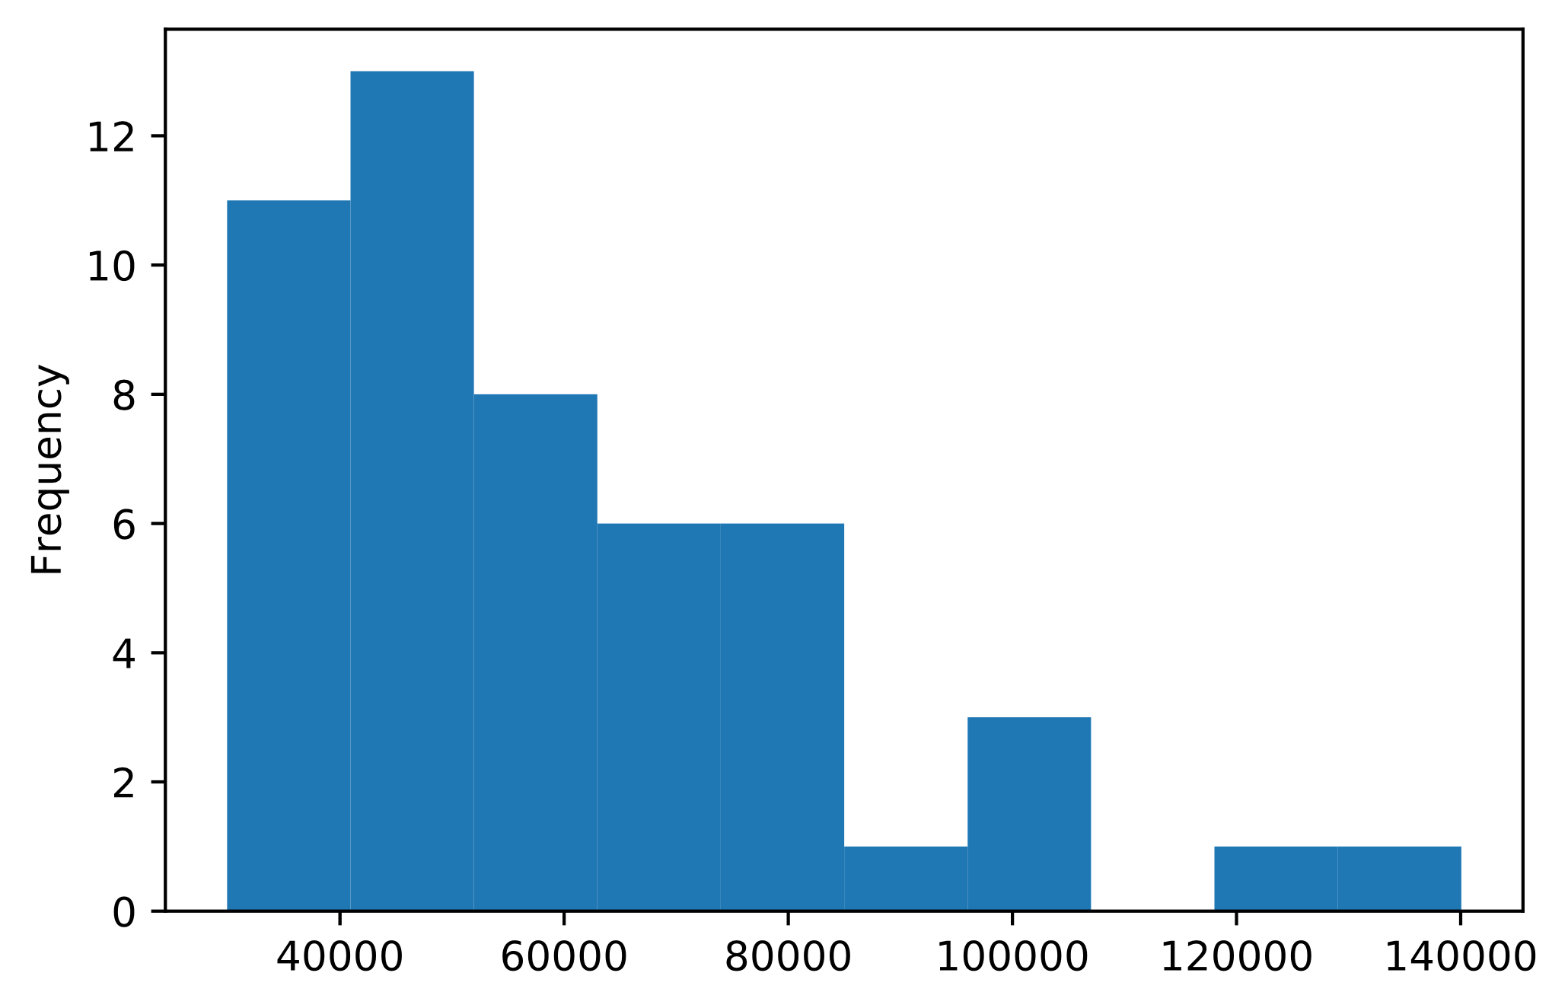
Histograms
census_df['Income'].plot(kind = 'hist')
Right-skewed distribution
Bin
Range of continuous variable

Slide 40
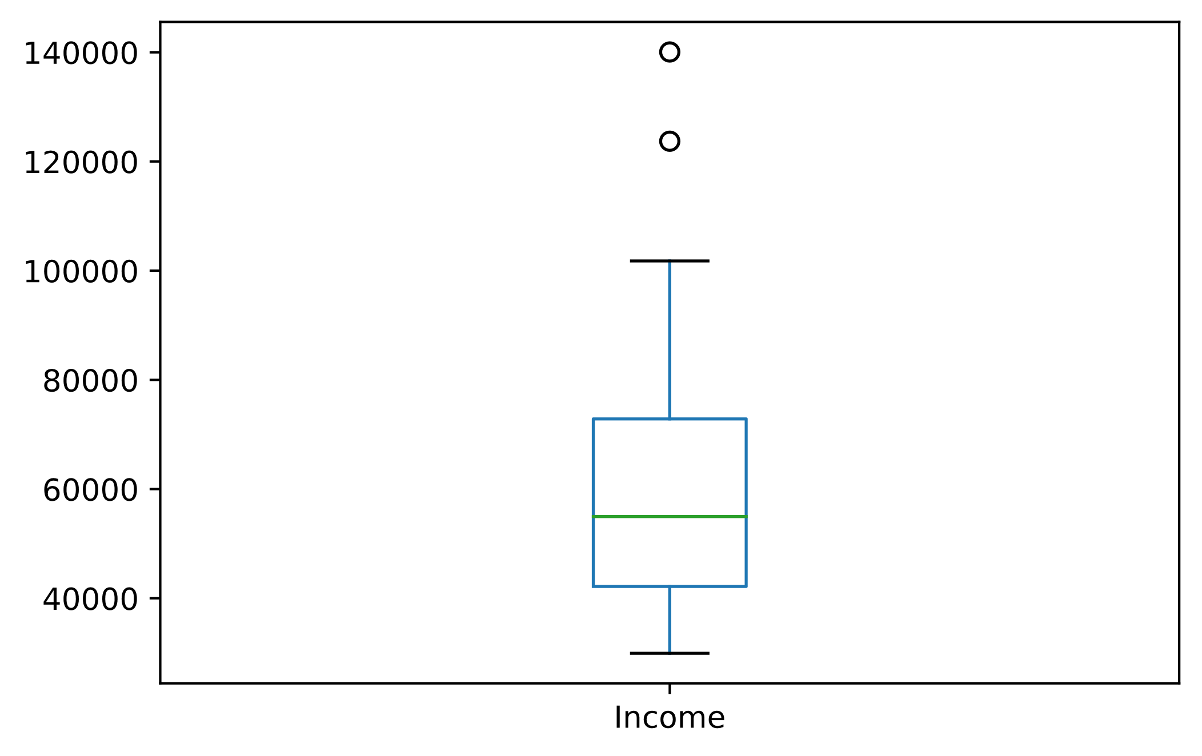
Box Plots
census_df['Income'].plot(kind = 'box')
Outlier
Max
Median
Q3
Q1
Min

Slide 41
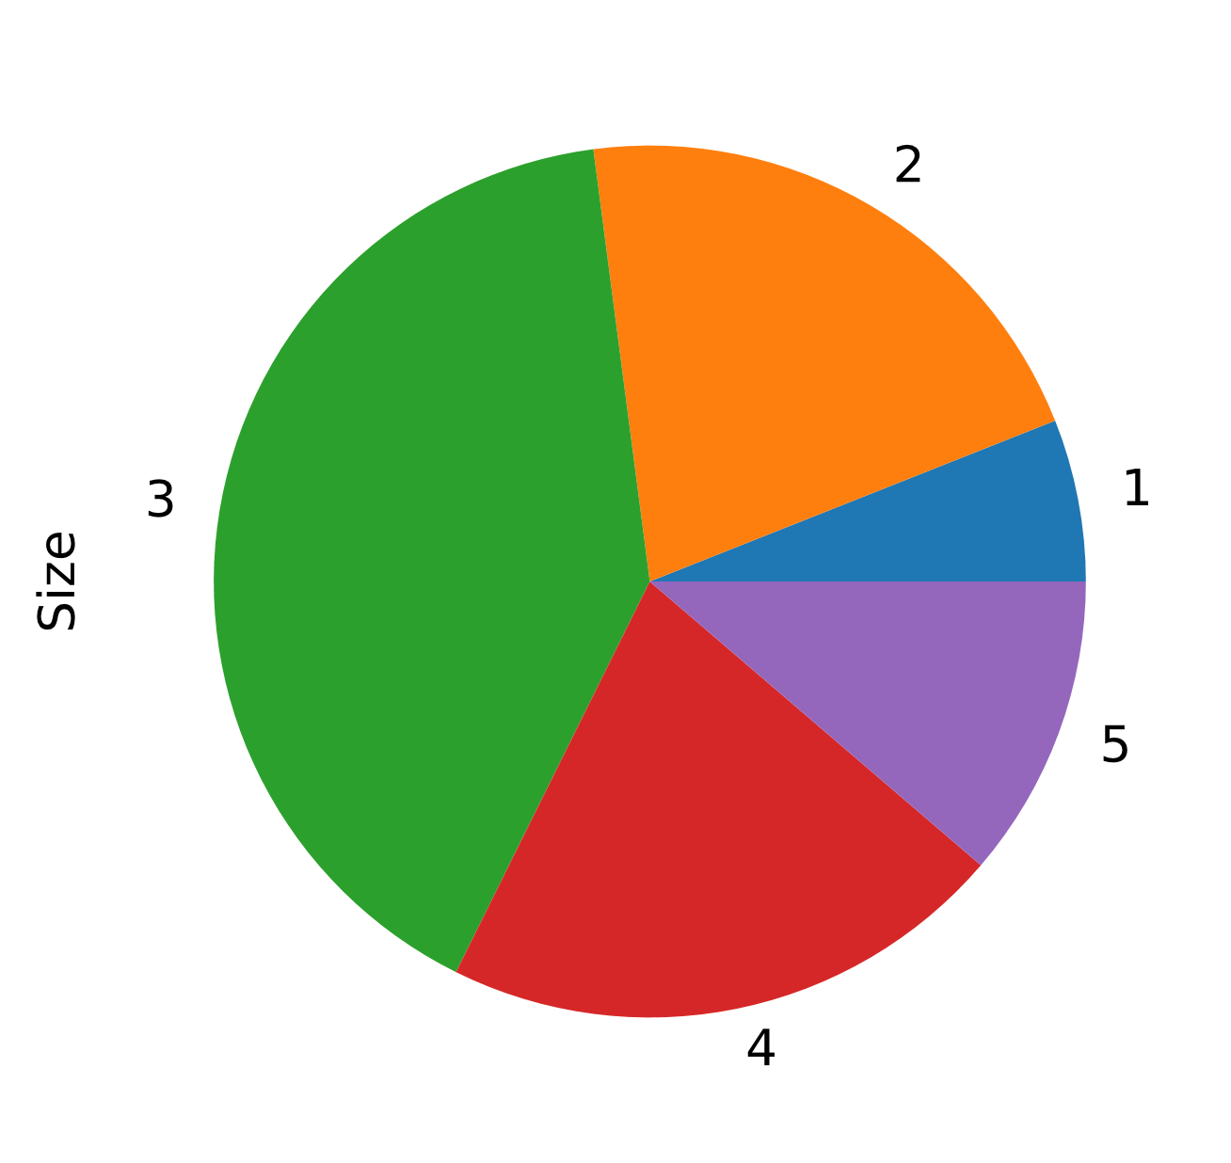
Pie Charts
census_df.groupby('Size')['Size'].sum().plot(kind = 'pie')
Most common household size
Least common household size

Slide 42
Guidelines for Plotting DataFrame Data
Consider using plot() from pandas to quickly plot data from a DataFrame.
Use scatter plots to show the relationship between two numeric variables.
Use line plots to show this relationship with a line drawn from point to point.
Use to show trends over time.
Use area plots to emphasize the trend of data in a line plot.
Use bar charts to show how categorical variables compare based on a measurement.
Consider grouping categorical variables first.
Use histograms to show distribution of a variable through bins.
Use box plots to show distribution of a variable through summary statistics.
Avoid pie charts.
If you must use them, supplement them with bar charts.

Slide 43
Activity: Plotting DataFrame Data
GCE store data is in a good state.
Although you've looked at summary statistics, visualizing them would be better.
Visuals can also help your non-technical audience understand the data.
You'll create basic plots for now.

Slide 44
Considering your own data, why might you pivot or group that data?
Considering your own data, what are some reasons why might you drop a record from a DataFrame?

